Slide 1
Visualising Data Wrangling Operations: Joins and Reshaping
Charco Hui
Supervisors: Anna fergusson, Chris wild

Slide 2
Question
What is Left Join?

Slide 3
What joins are about
Combining information from different data tables by using key columns to match records.
Different type of joins
Left Join
Right Join
Inner Join
Complete Join

Slide 4
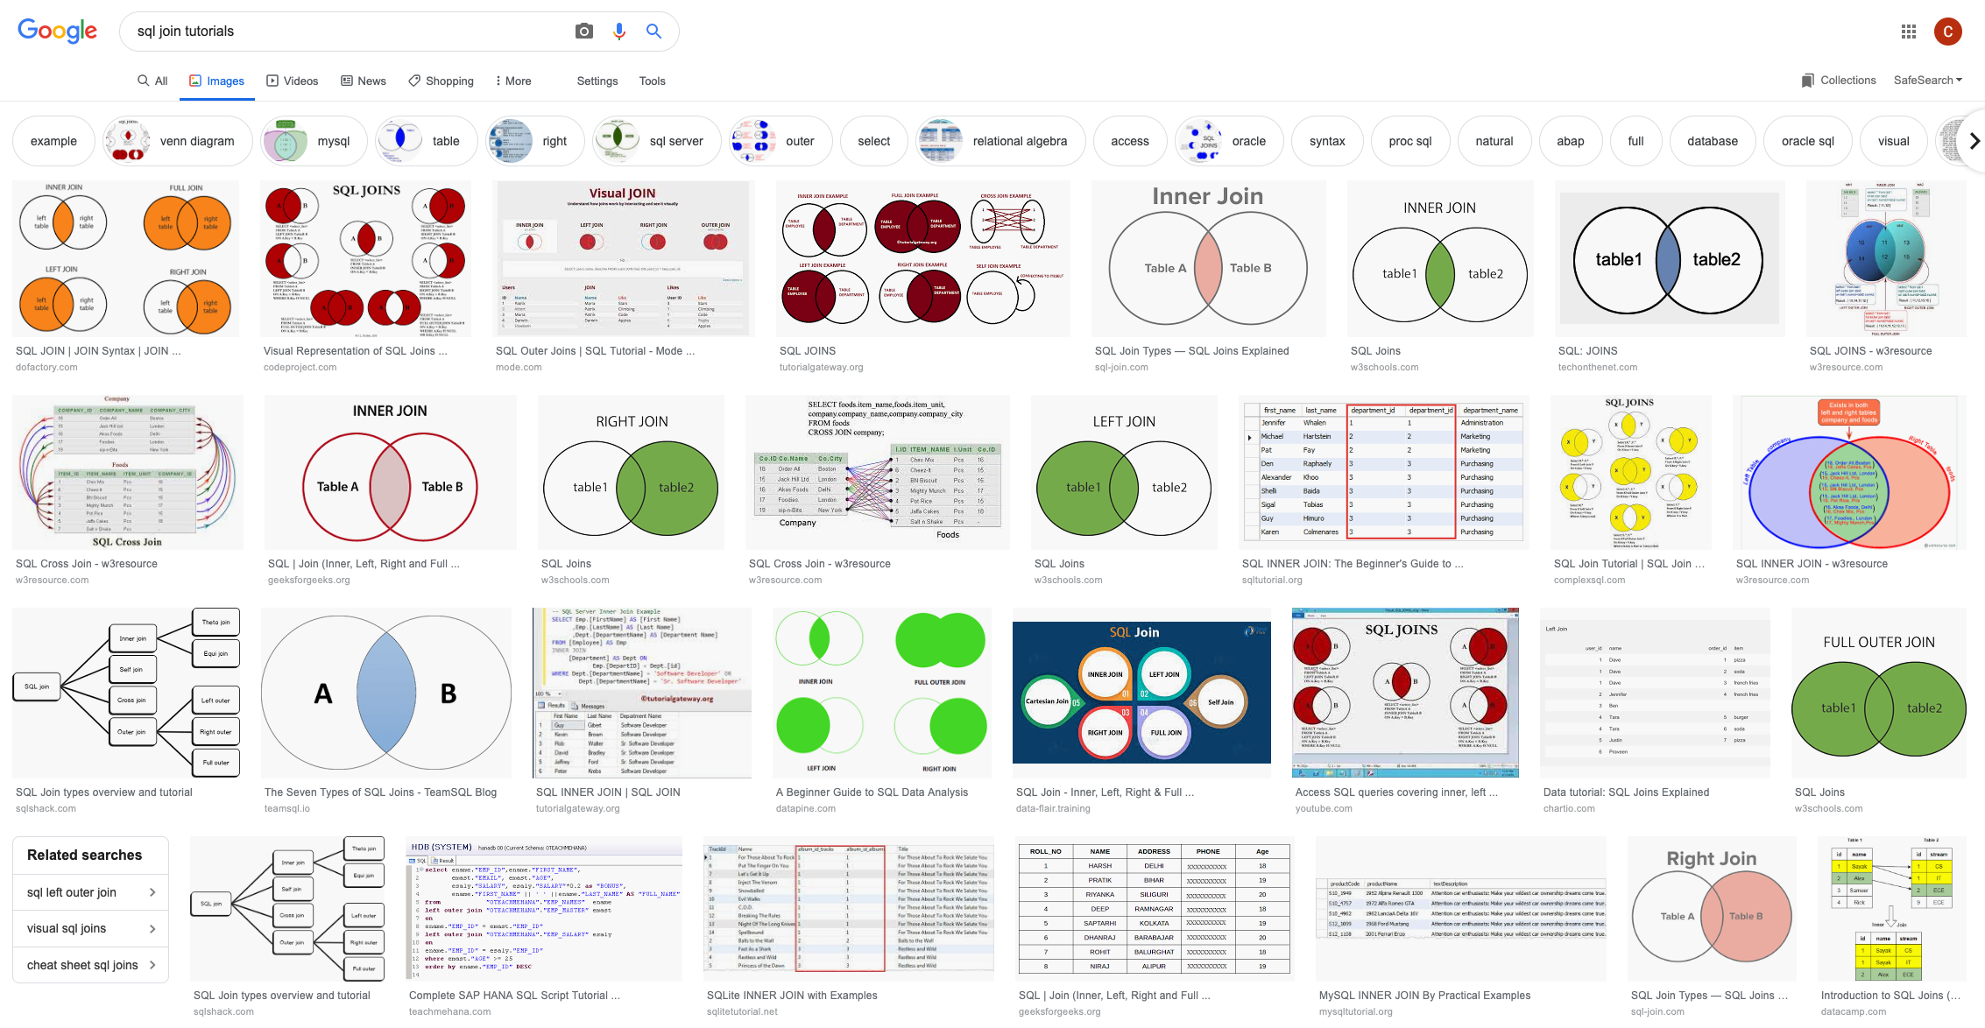
Most Popular Visualisation Approach
What do these tell you about a join?

Slide 5
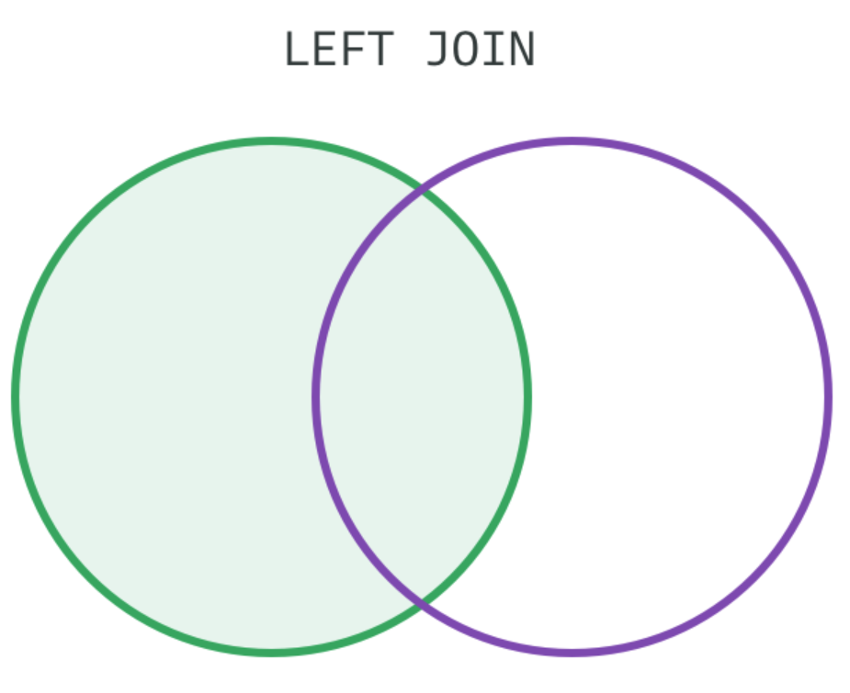
Current Approach 1
Limitations:
Don’t look like data tables.
Vague on how the joins work.
Does not explain unmatched rows or multiple matches.
Useful Features:
Useful reminder about what rows get used.

Slide 6
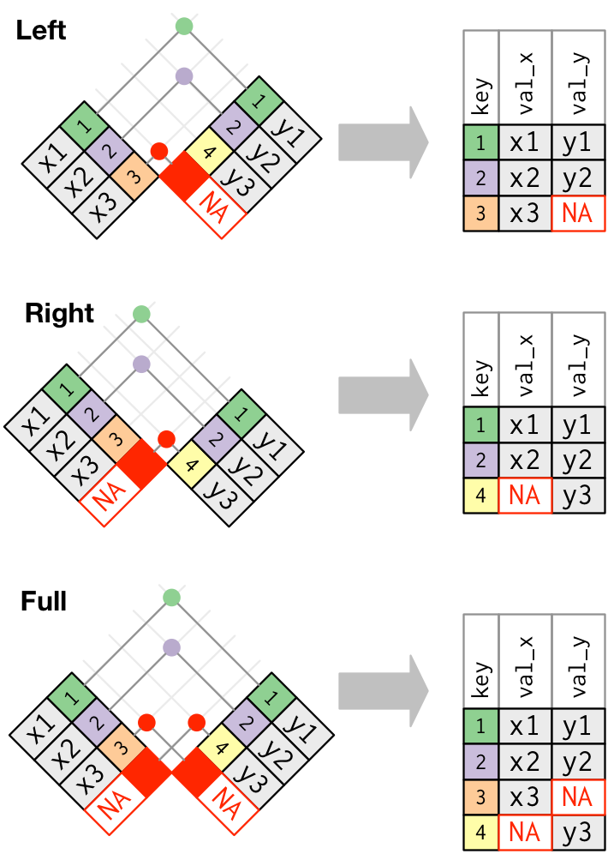
Current Approach 2
Advantages compared to Venn Diagrams:
Each table and rows are shown nicely.
Line linking rows that are matched together.
Joined table shown.
What is missing:
No verbal descriptions.
Does not explain multiple matches.
Would be messy for larger tables.
R for Data Science Approach
(Wickham and Grolemund, 2017)

Slide 7
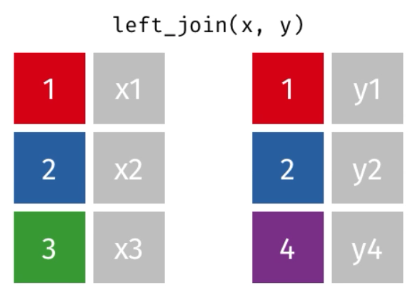
Current Approach 3
Limitations:
Lack explanations of how unmatched and duplicated rows are treated.
No explanations of how rows are joined together.
Advantages:
Animation catches attention.
Left join Animation – tidyexplain (Aden-Buie, 2018)

Slide 8
Improvements
Show why or how rows are joined together.
Show how duplicated, unmatched and multiple matching rows are joined together.
Convey the idea of key columns.
Displaying messages to show the logic behind each step of the joins.
Allow users to input their own data to produce the animations.
Control playback speed.
Ability to save an animation for use in webpages and presentations.

Slide 9
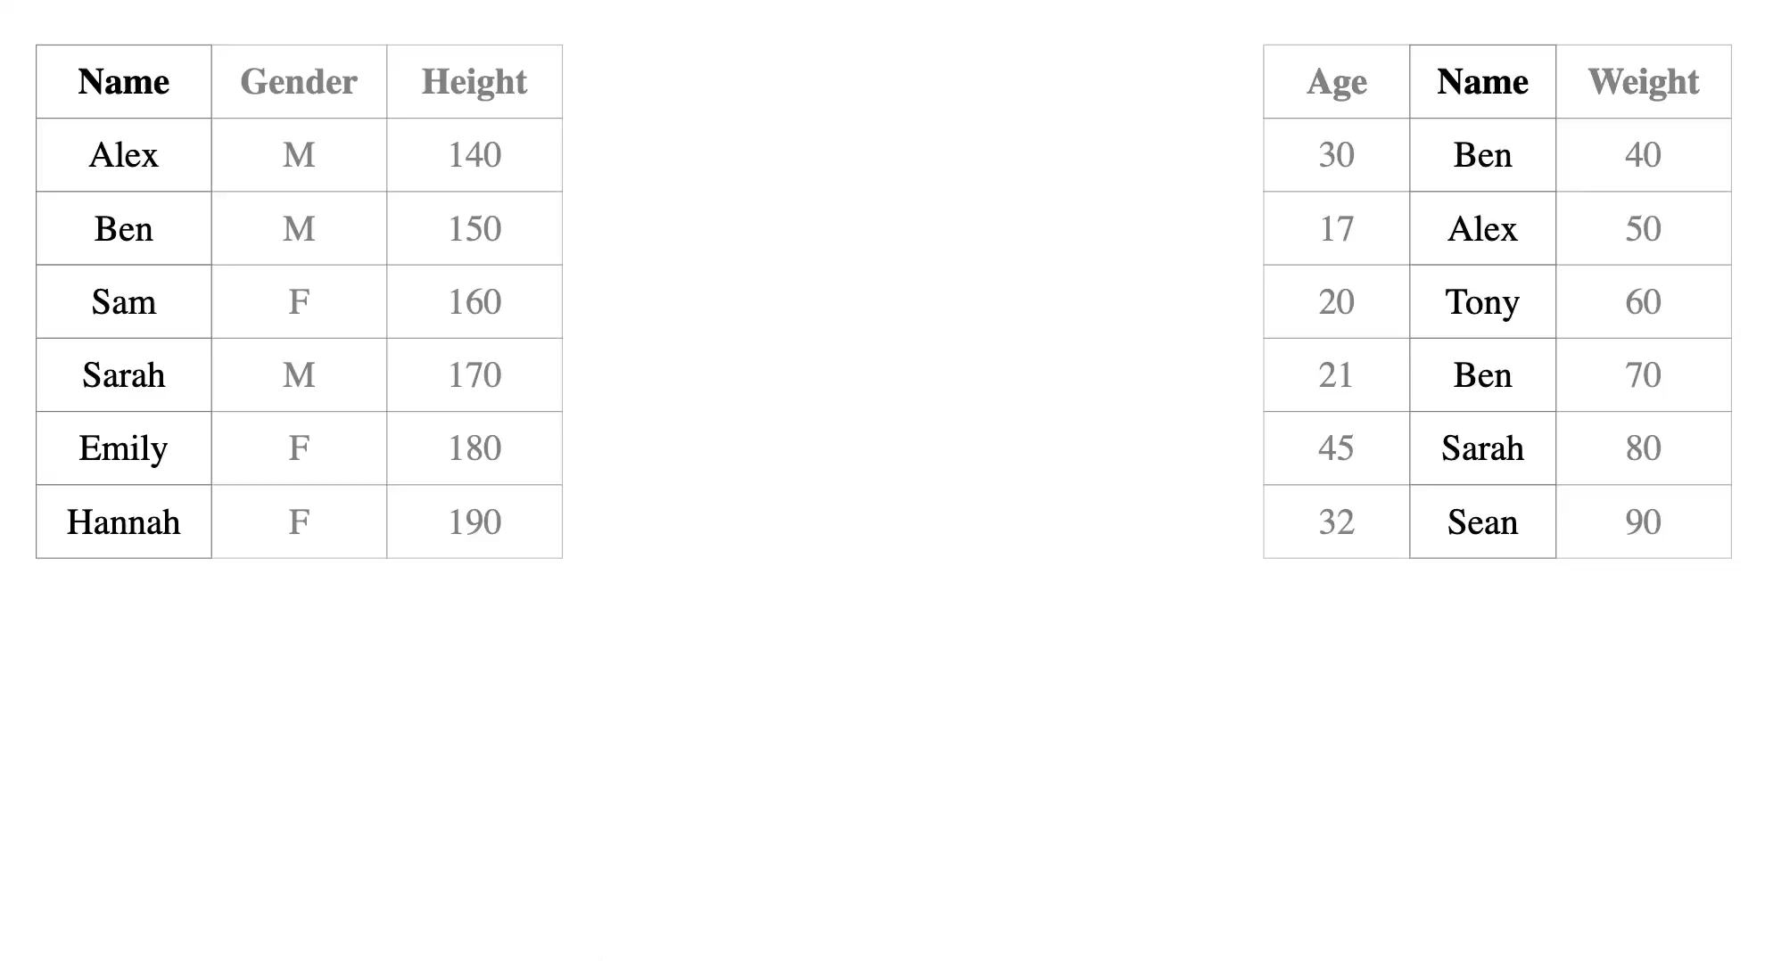
dataAnim Approach

Slide 10
Data Transformation
Data transformation (Sauser, 2016)

Slide 11
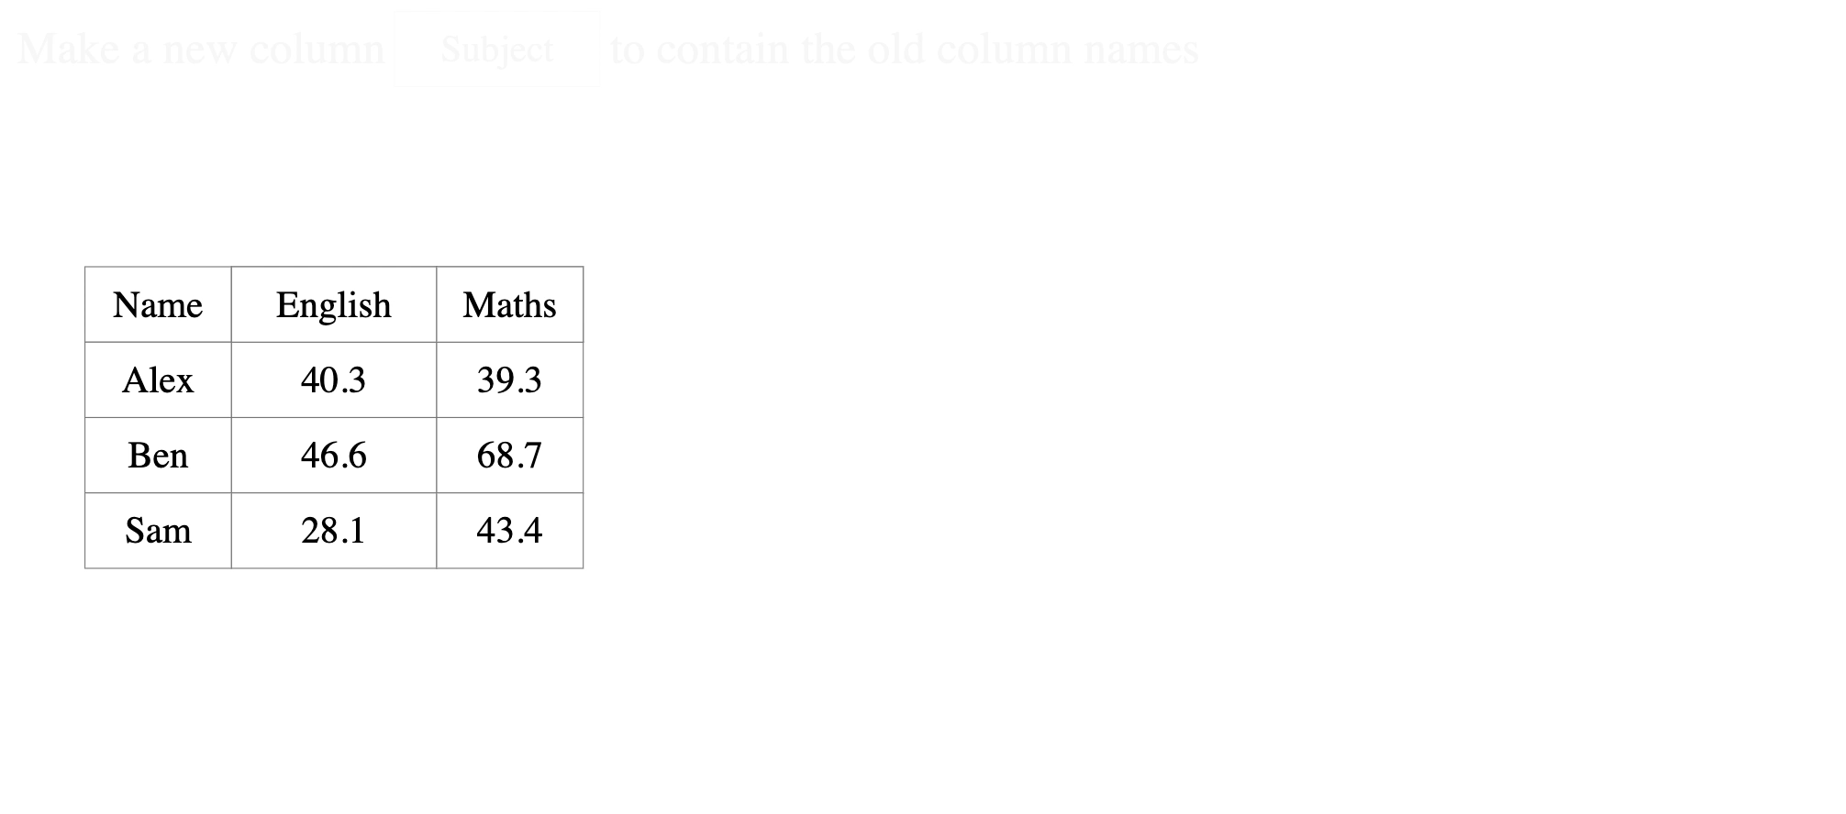
dataAnim Approach Reshaping

Slide 12
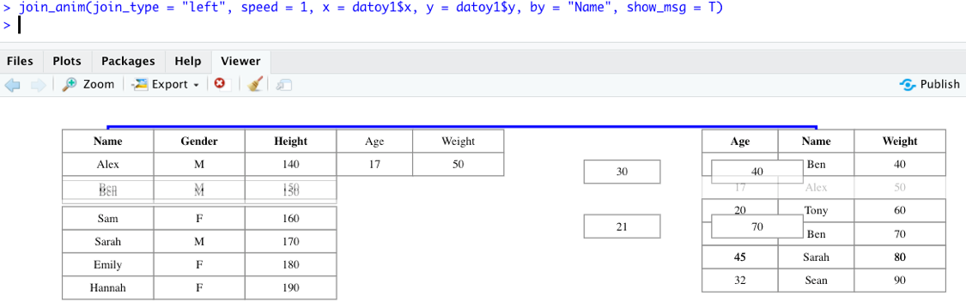
dataAnim Package Rstudio
Installing dataAnim:
devtools::install_github(“chrk623/dataAnim”)

Slide 13
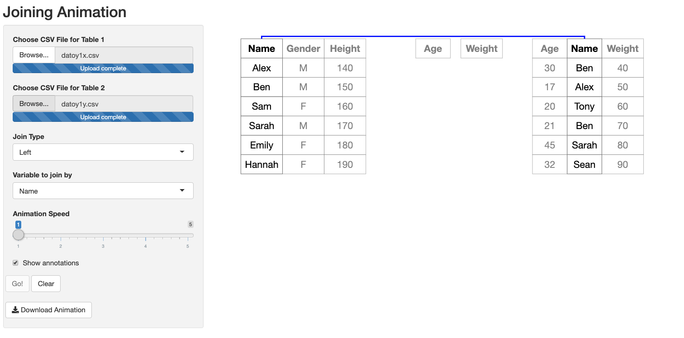
dataAnim Package Shiny App
Shiny App: https://chrk623.shinyapp.io/dataAnim_shiny

Slide 14
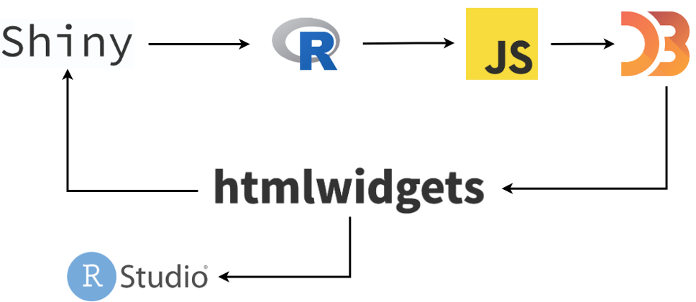
dataAnim Package Software Structure

Slide 15
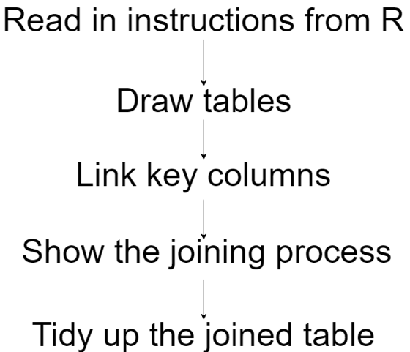
dataAnim Package JavaScript Program Flow

Slide 16
Conclusion
dataAnim Package:
Different techniques used to catch users attention.
Messages to explain steps of different data wrangling operations.
Shiny App:
Extension to a shiny app for ease of use.
Used in the help page of iNZight.
Future work:
Testing on students/teachers.
Allow for more complicated situations in the software.
Export as movie.
SQL module.

Slide 17
Thank You.

Slide 18
dataAnim Left Join Key column

Slide 19
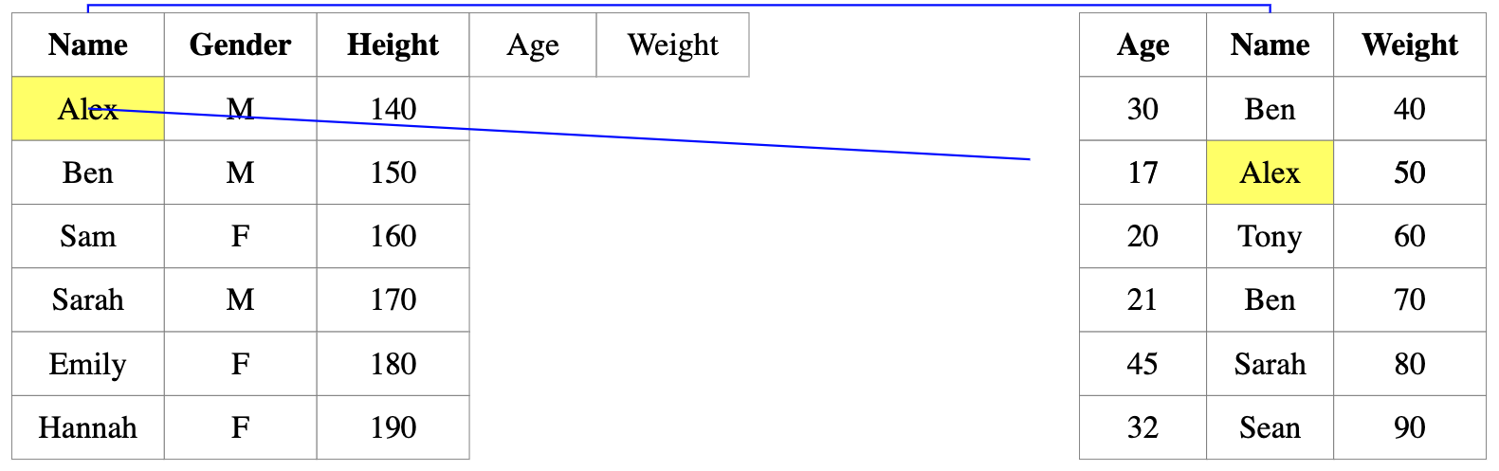
dataAnim Left Join Single match – Step 1

Slide 20
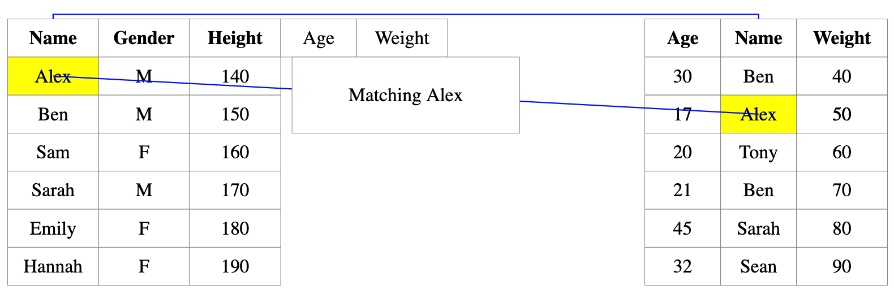
dataAnim Left Join Single Match – Step 2

Slide 21
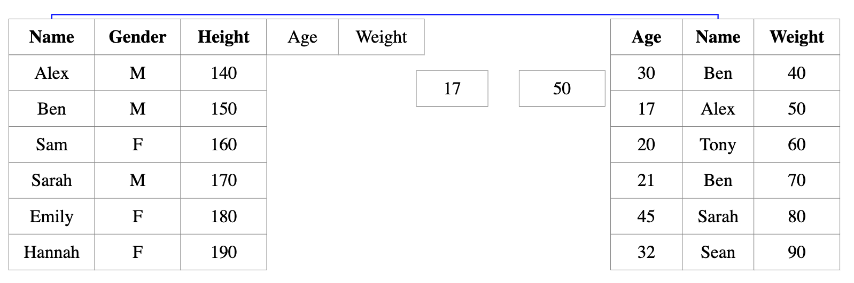
dataAnim Left Join Single match – Step 3

Slide 22
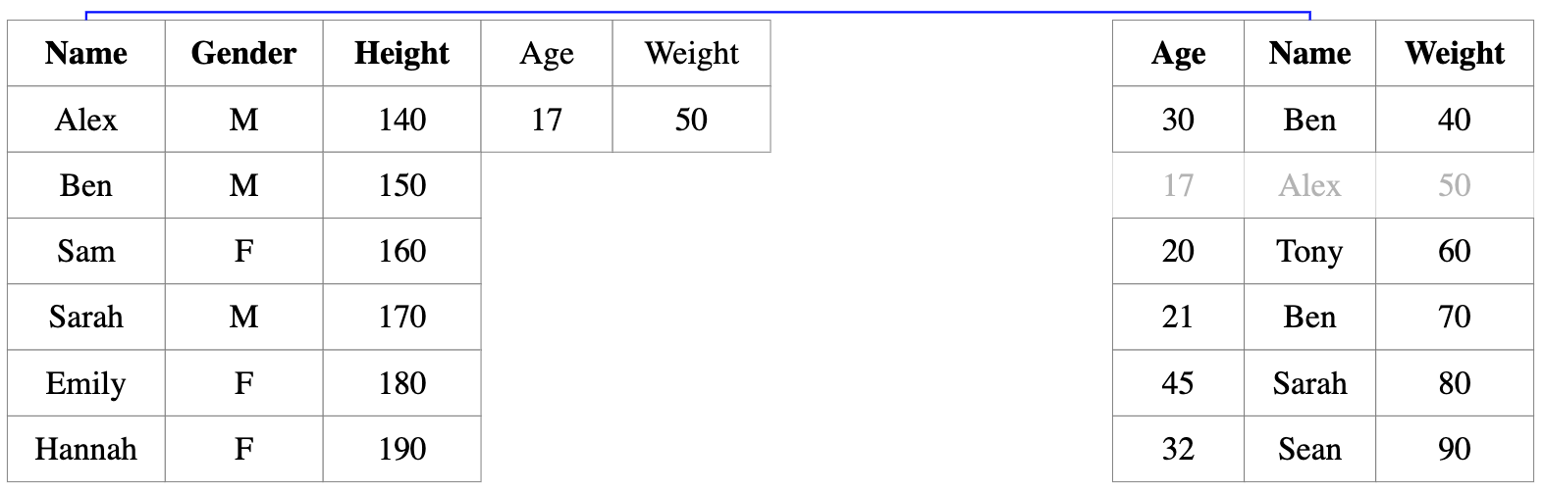
dataAnim Left Join Single Match – Step 4

Slide 23
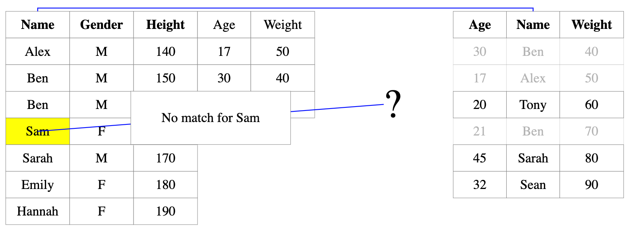
dataAnim Left Join No Match

Slide 24
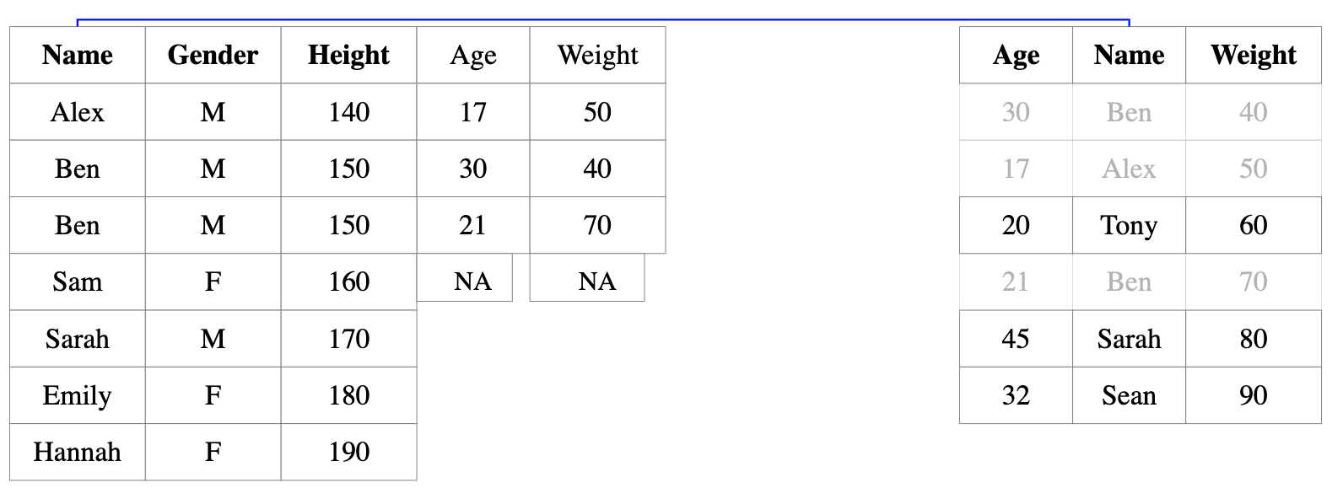
dataAnim Left Join No Match – Step 2

Slide 25
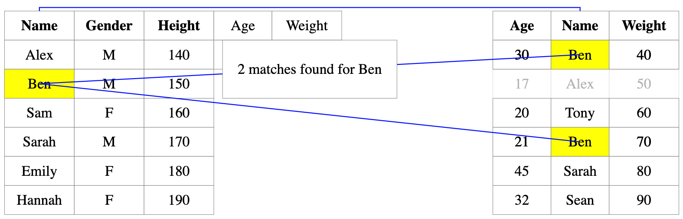
dataAnim Left Join Multiple Match – Step 1

Slide 26
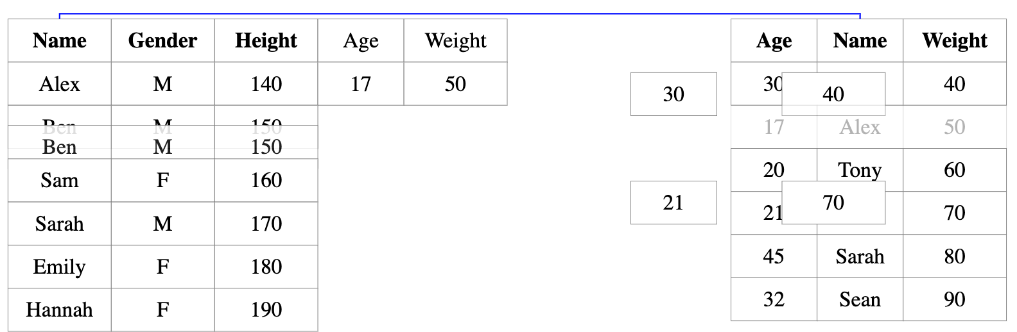
dataAnim Left Join Multiple Match – Step 2

Slide 27
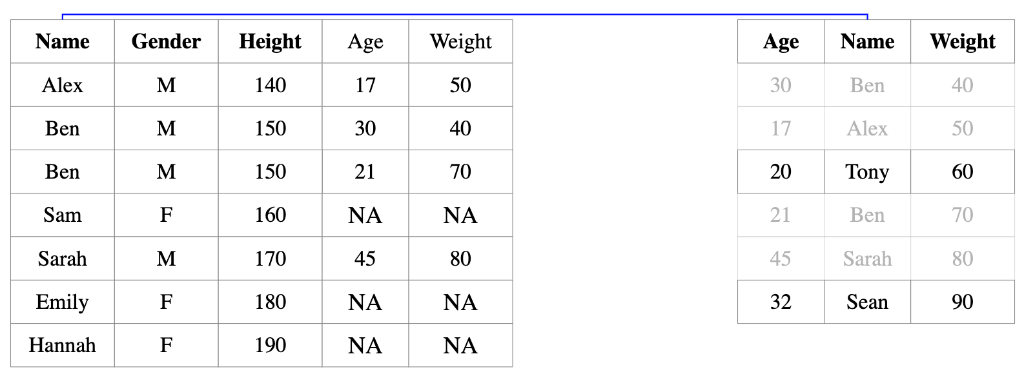
dataAnim Left Join End of joining

Slide 28
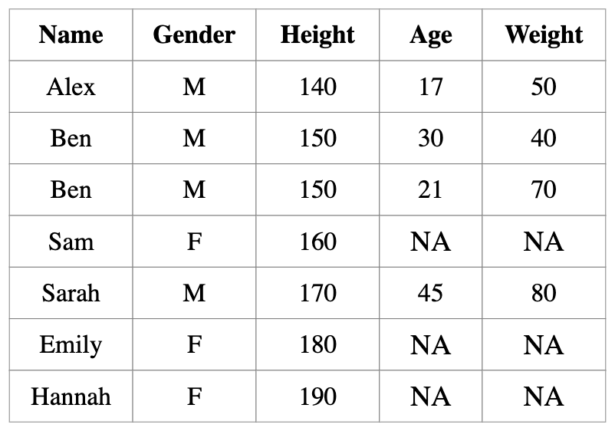
dataAnim Left Join Tidy up

